Slide 1


Slide 2
Web page evolution.
What is React JS? Why React JS?
React Concepts
Code Time!!

Slide 3
Web page evolution

Slide 4
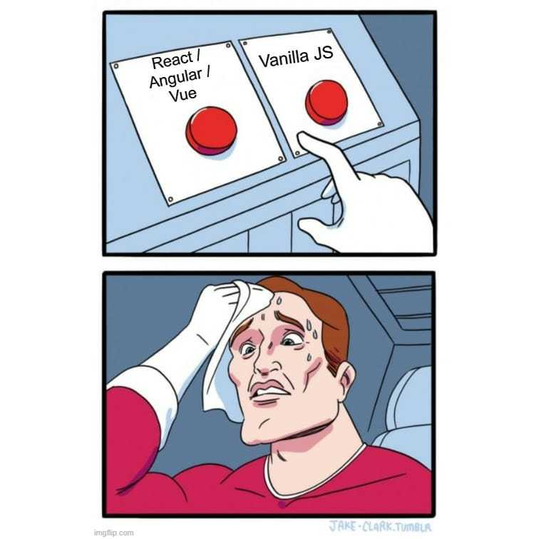

Slide 5
React vs Vanilla JS
Web apps can be complex and may require a lot of dynamic functionalities.
One can opt for Vanilla JS to build their applications but if you have worked with Vanilla JS before, you know how messy it can get. Here's when JS frameworks like, React, Angular and Vue, come into the picture.

Slide 6
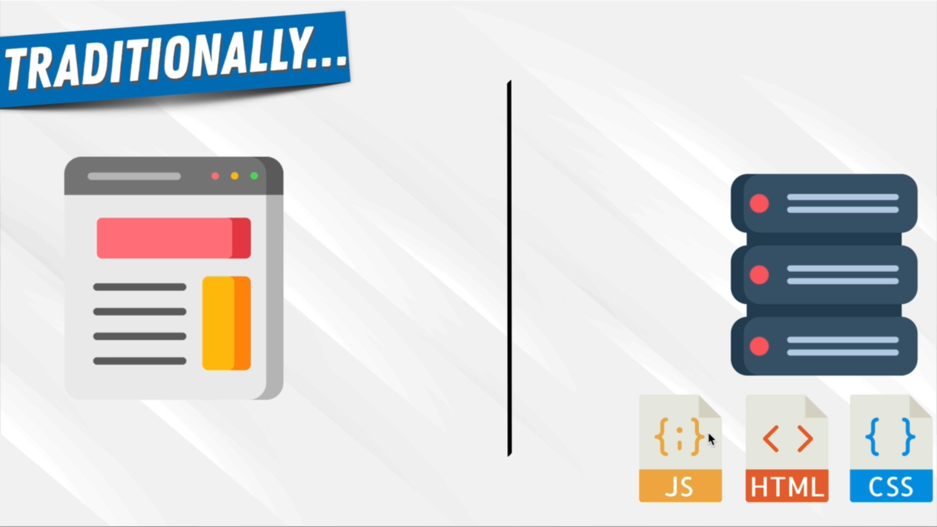

Slide 7
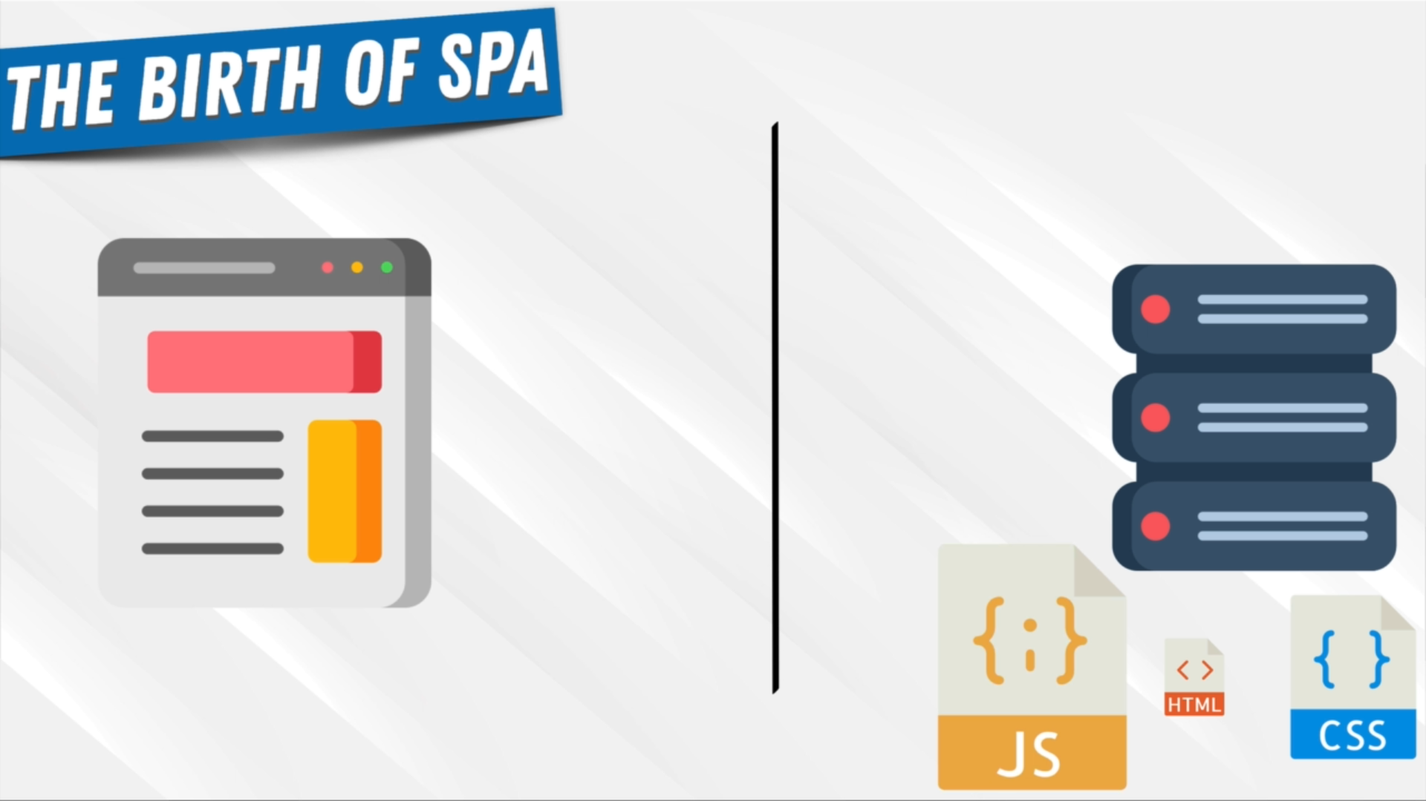
Less focus on HTML
More focus on JavaScript

Slide 8
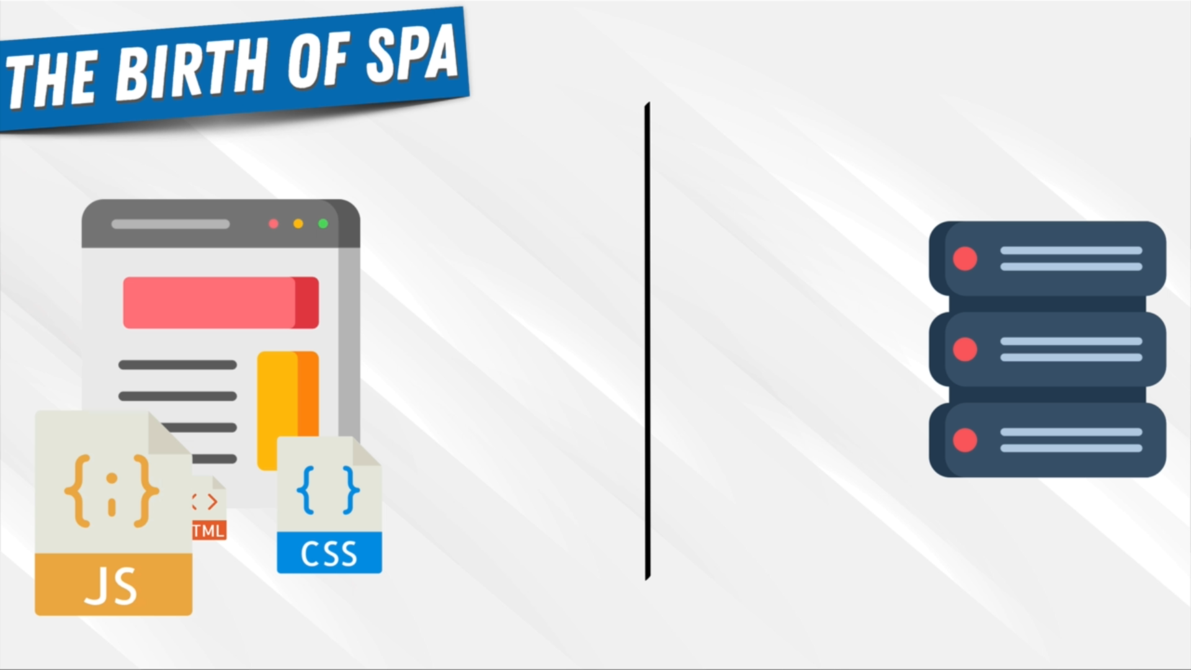
Load the page once
While we stay on the same page... Javascript changes (updates) the HTML file (DOM) to display new things

Slide 9
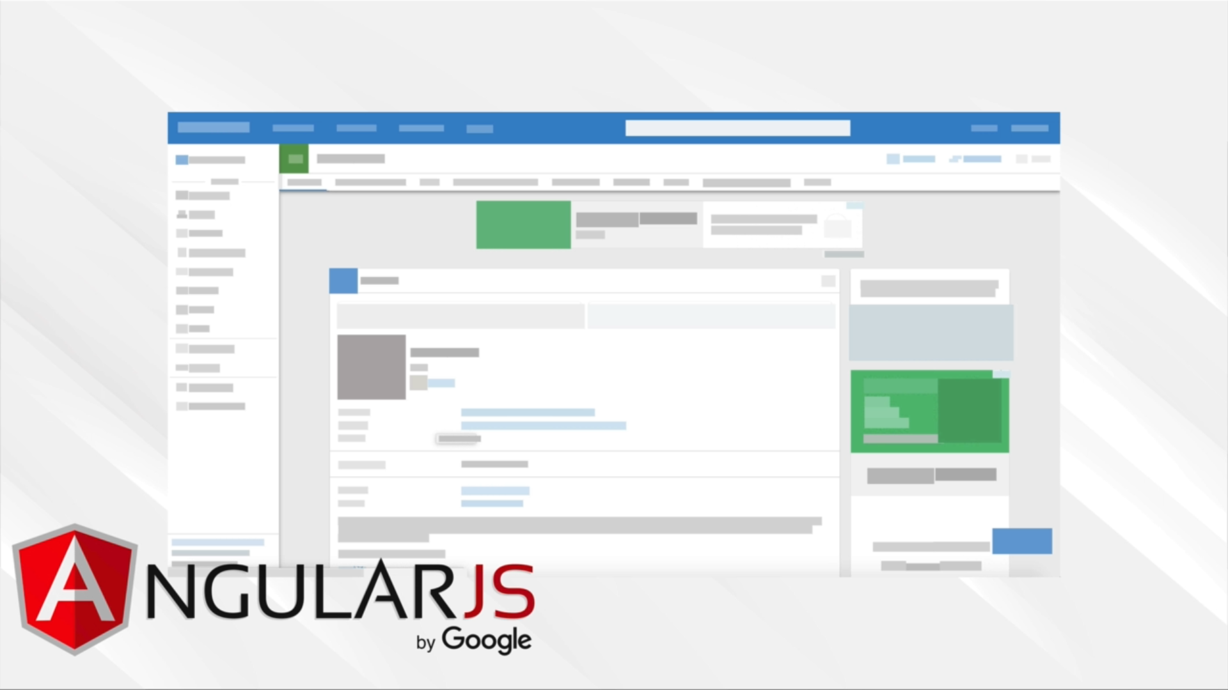
In 2010

Slide 10
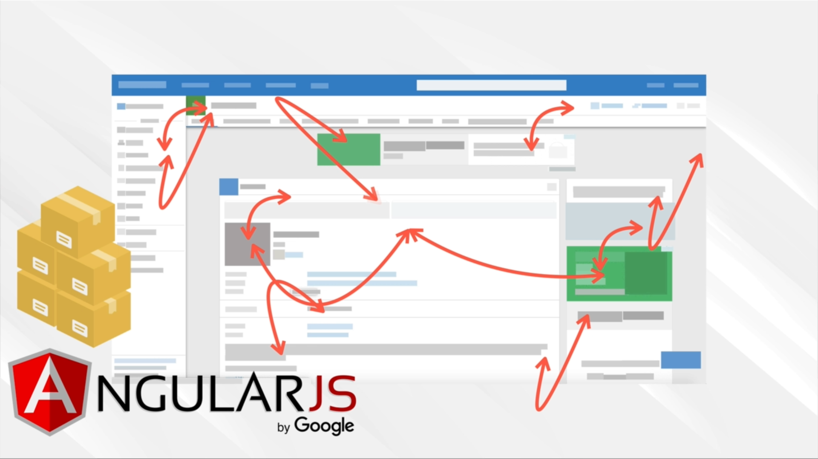
Things start getting more and more complex!
Users have more and more interaction

Slide 11

It’s getting harder and harder to find bugs

Slide 12

What is

Slide 13
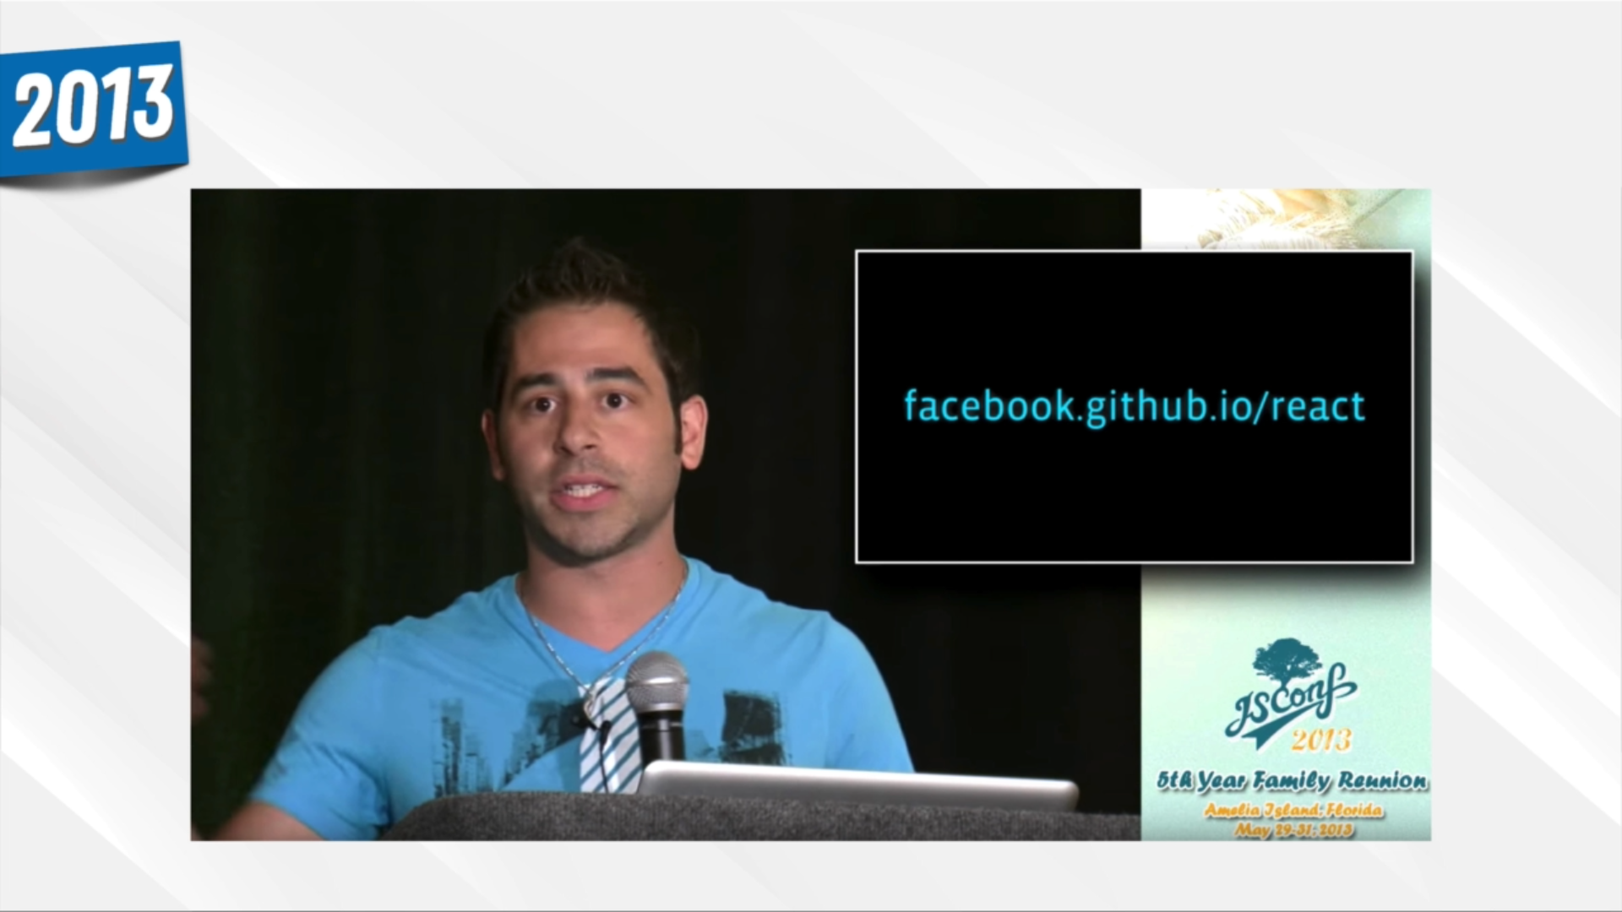

Slide 14
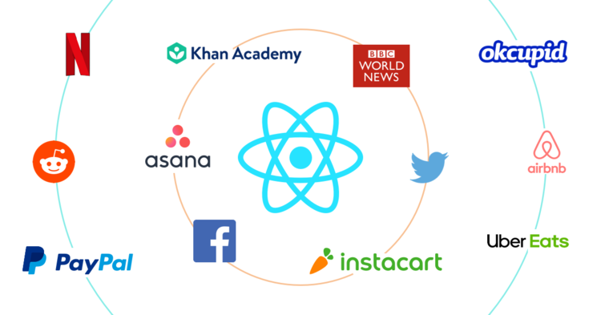
Notes:
Asana est un gestionnaire de communication d'équipe.
Airbnb est une société américaine de marché en ligne de location de vacances basée à San Francisco,
Reddit est un site web communautaire américain d’actualités sociales fonctionnant via le partage de signets permettant aux utilisateurs de soumettre leurs liens et de voter pour les liens proposés par les autres utilisateurs.

Slide 15

React is:
A Library
User Interface (UI) library,
Tool for building UI components
Used with JSX
Javascript Syntax eXtension
A mix of HTML and JS
Component-Based
Like Legos!
Uses A Virtual DOM
Huh ?!
Notes:
React has quickly become one of the most popular JavaScript libraries. This is entirely because of its flexibility and the improvement it brings in the performance. React breaks down the UI into smaller and reusable components that can move around data amongst each other. This breaking down of the UI is what gives React an edge over Vanilla JS.

Slide 16
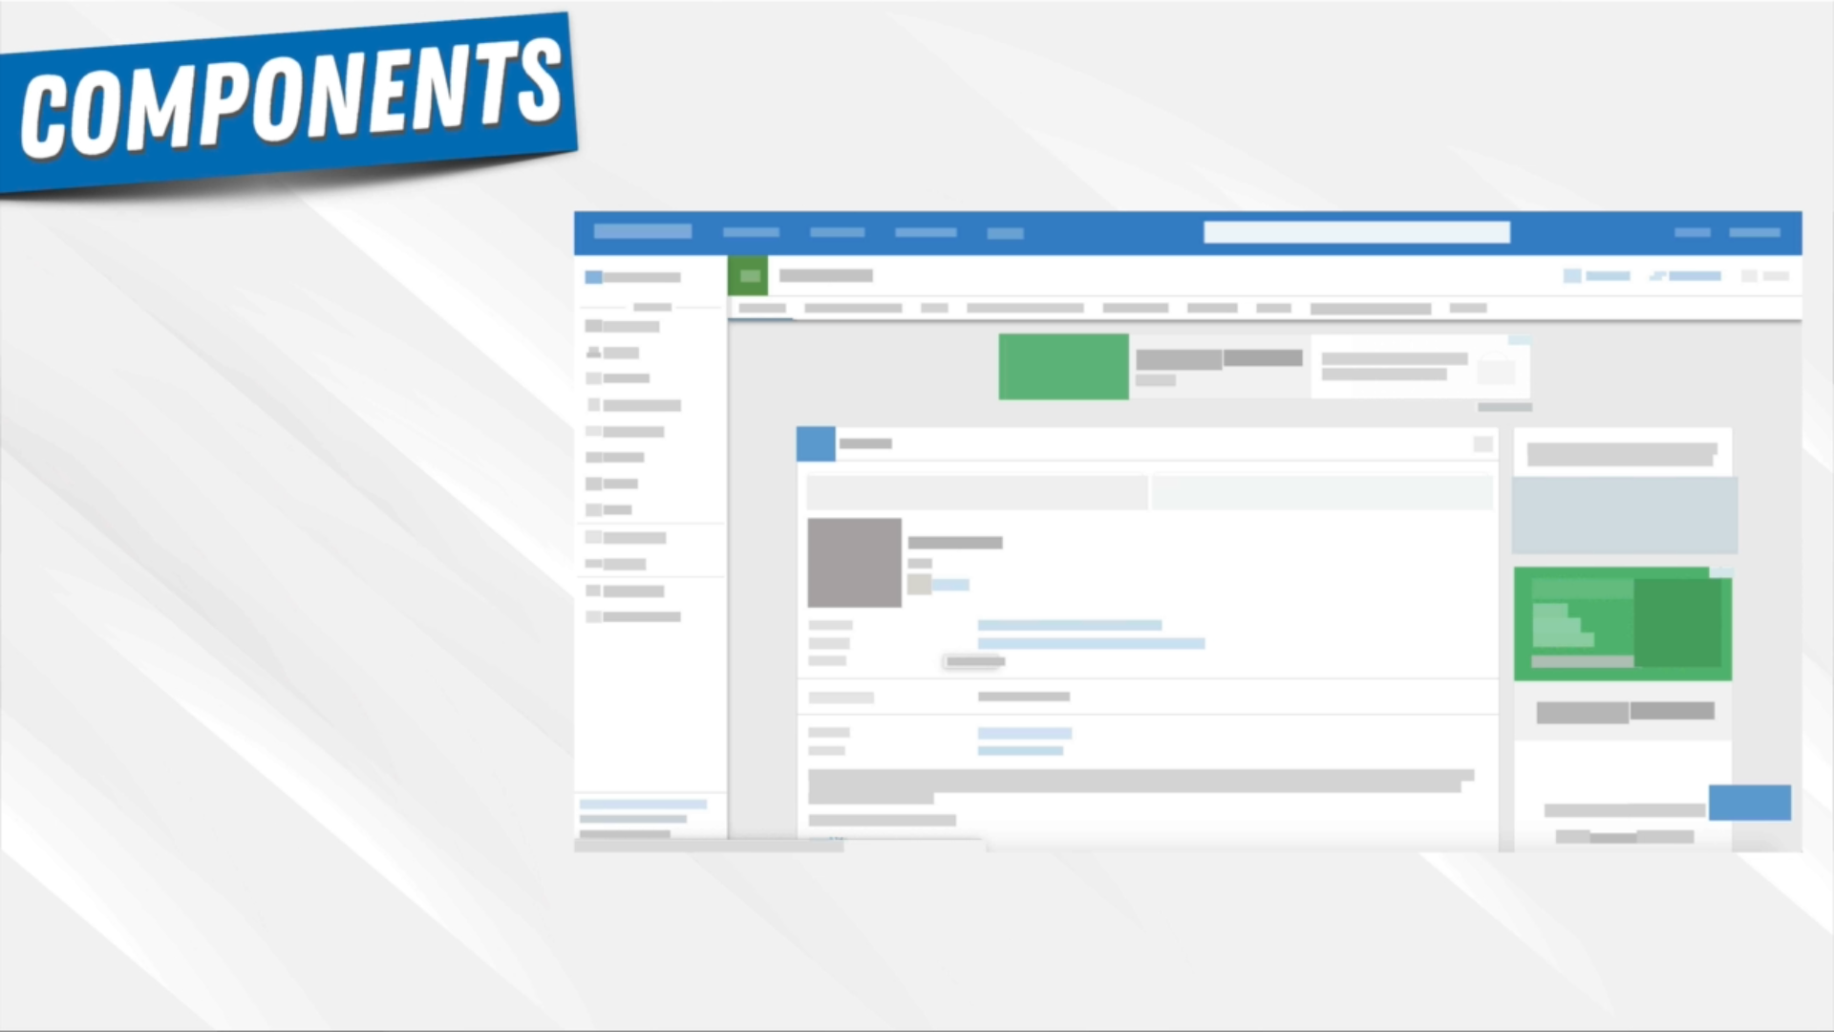

Slide 17
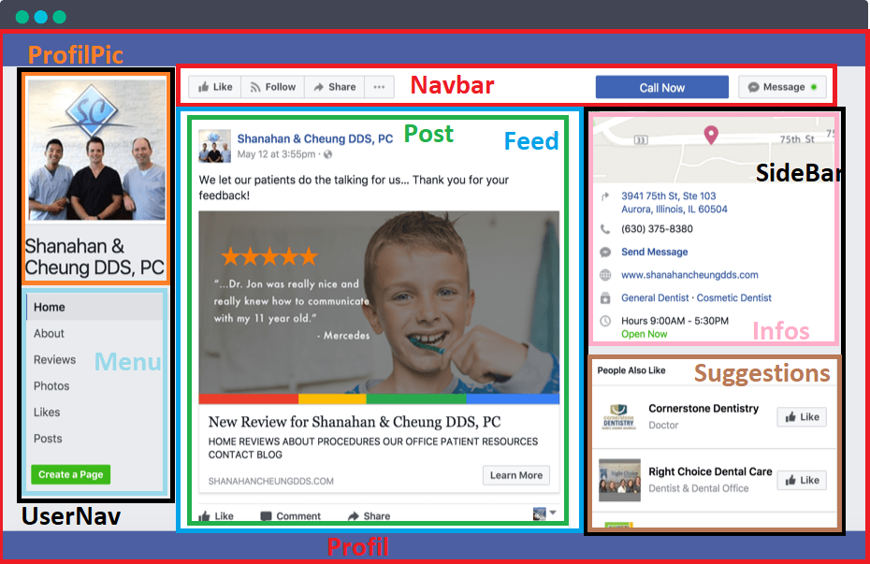

Slide 18
TREE COMPONENT
Profil
UserNav
NavBar
Feed
SideBar
ProfilPic
Menu
Post
Infos
Suggestions

Slide 19
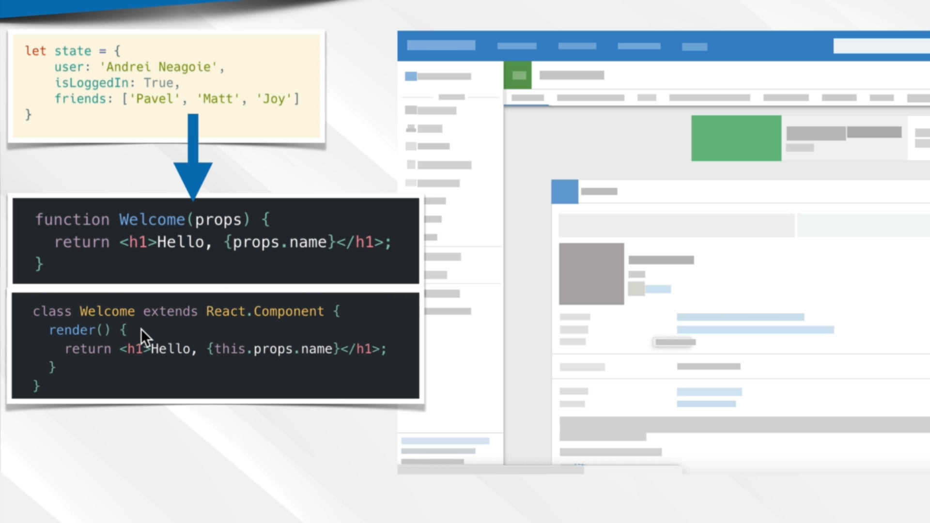
data
‘Go My Code’
Go My Code
Go My Code

Slide 20
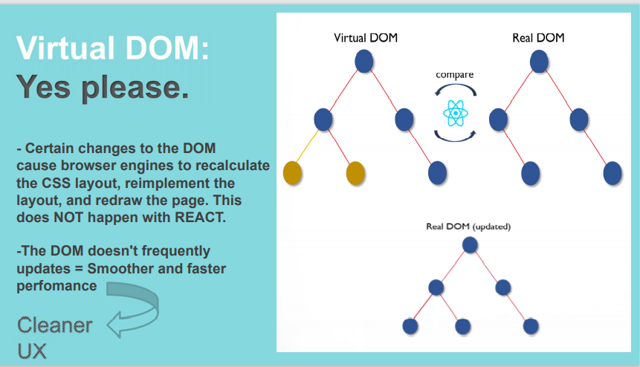

Slide 21
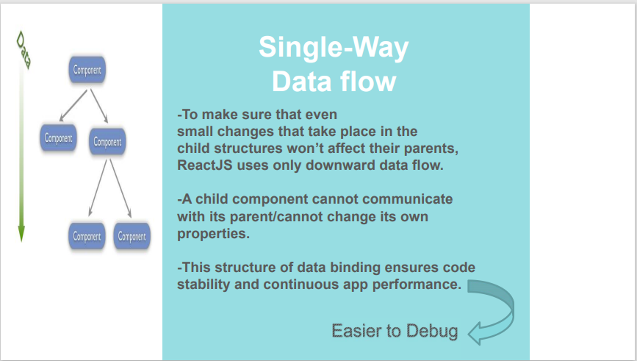

Slide 22
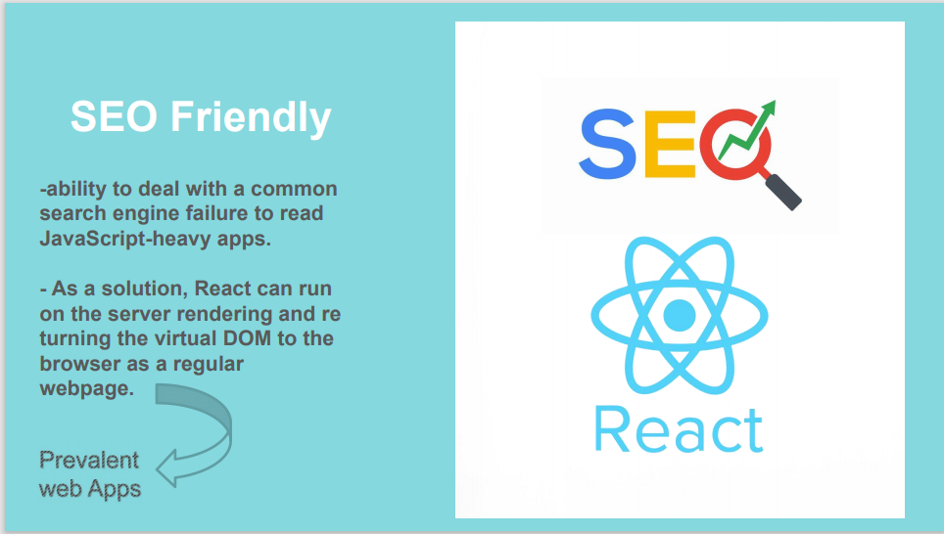

Slide 23
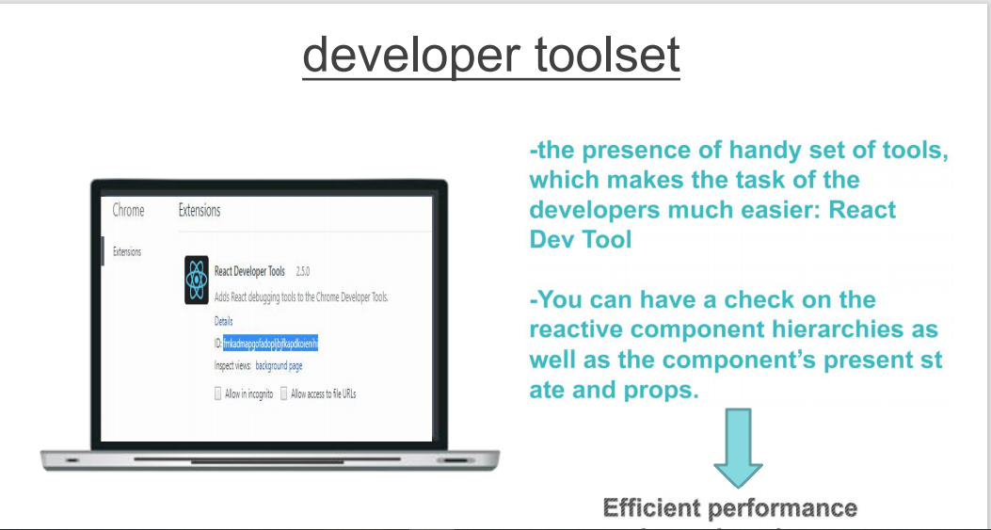

Slide 24
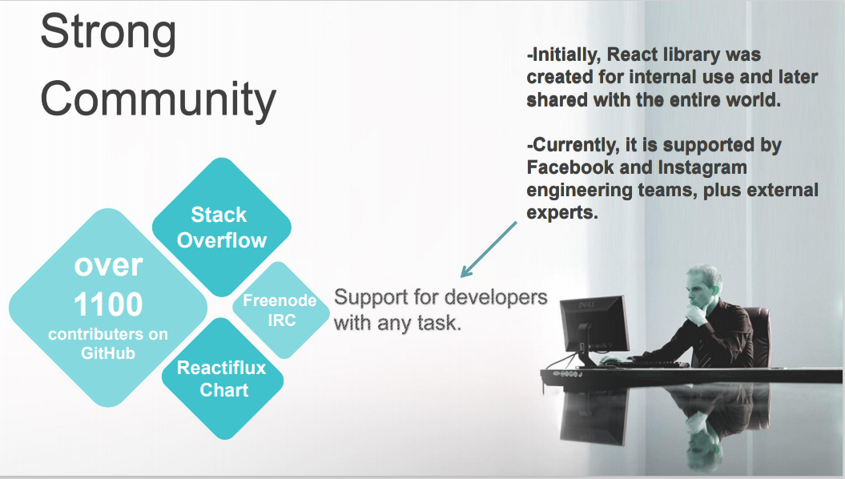

Slide 25
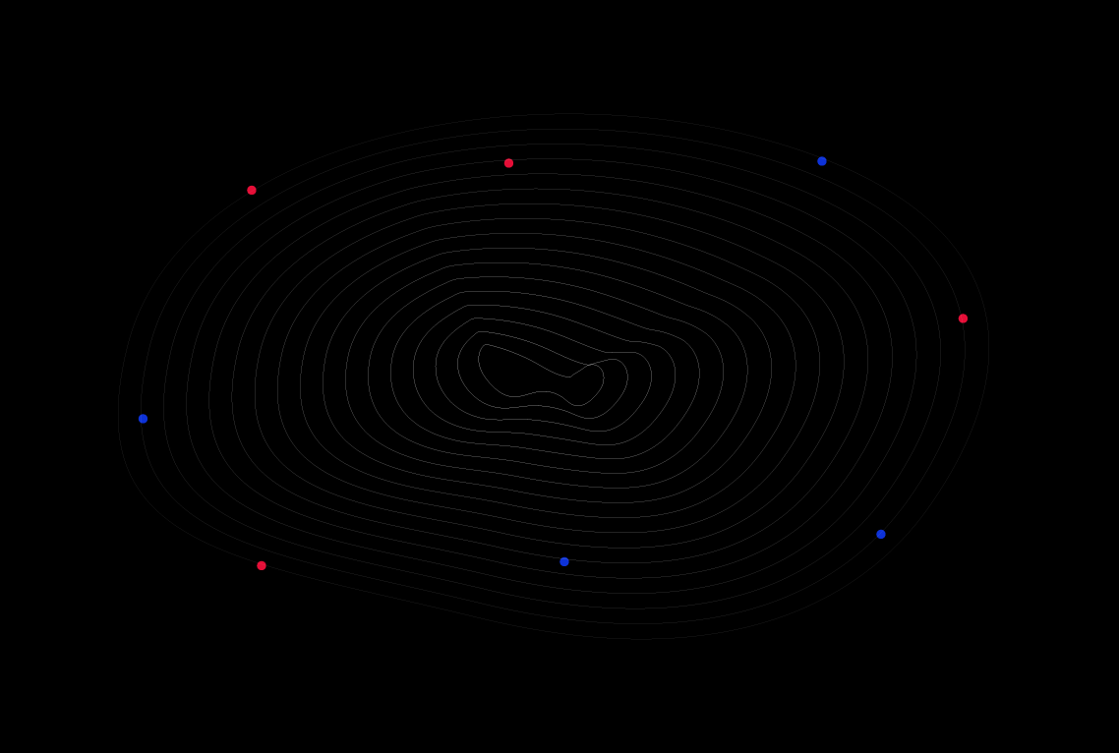
Live code Session

